Slide 1
8086/8088 Hardware Specifications
Prof. Virender Kumar Ranga

Slide 2
Pin-Outs & The Pin Functions
Pin-Out (see Fig. 8-1)
  Both are packeged in 40-pin dual in-line packeges (DIPs)
  The major difference between 8086 & 8088
    8086 is a 16-bit microprocessor with a 16-bit data bus (pin connections AD₀ - AD₁₅)
    8088 is a 16-bit microprocessor with an 8-bit data bus (pin connections AD₀ - AD₇)

Slide 3
Pin-Outs & The Pin Functions (cont’d)
  The minor difference in one of the control signals
    8086 has an M/IO pin
    8088 has an IO/M pin
  The only other hardware difference appears on pin 34 of both chips :
    on the 8080, it is an SSO pin
    on 8086, it is BHE/S₇ pin
  Power Supply Requirements
    Both nedds +5.0V with a supply voltage tolerance of ± 10 %

Slide 4
Pin-Outs & The Pin Functions (cont’d)
  DC Characteristics
    input characteristics compatible with all the standard logic components available today (see Table 8-1)
    output characteristics, logic 1 level is compatible with that of most standard logic families, and logic 0 level is not
  Pin connections (The Pin Functions : Study page 289 - 290)

Slide 5
Clock Generator (8284A)
It is an ancillary component to the 8086/8088 microprocessors. The 8284A provides the following basic functions or signals :
    clock generation
    RESET synchronization
    READY synchronization
    a TTL level peripheral clock signal (see Fig 8-2)
  Pin Functions (study page 291-292)
  operation of the 8284A (see Fig. 8-3)

Slide 6
Bus Buffering and Latching
Demultiplexing the Buses
    All computer system have three buses :
      (1) an address bus that provides the memory and I/O
      with the memory address or the I/O port number
      (2) a data bus that transfers data between the
      microprocessor and the memory and I/O in the
      system
      (3) a control bus that provides control signal to the
      memory and I/O
  Demultiplexing the 8088 (see Fig. 8-5)
  Demultiplexing the 8086 (see Fig. 8-6)

Slide 7
Bus Buffering and Latching(cont’d)
The Buffered System
  the entire 8086 or 8088 system must be buffered, if more than 10 unit loads are attached to any bus pin
  a fully buffered signal will introduce a timing delay to the system
  the fully buffered 8088 (see Fig. 8-7)
  the fully buffered 8086(see Fig. 8-8)

Slide 8
Bus Timing
It is essential to understand system bus timing before choosing a memory or I/O device for interfacing to the 8086 or 8088 microprocessor
  Basic Bus Operation
    if data are written to the memory (see Fig.8-9), the microprocessor outputs the memory address on the address bus, outputs the data to be written into memory on the data bus, and issues a write (WR) to memory and IO/M = 0 for the 8088 and M/IO = 1 for the 8086

Slide 9
Bus Timing (cont’d)
    if data are read from the memory (see Fig. 8-10) the microprocessor outputs the memory address on the address bus, issues a read (RD) memory signal, and accepts the data via the data bus
  Timing in General
  The 8086/8088 microprocessor use the memory and I/O in periods of time called bus cycles. Each bus cycle = 4 system-clocking periods (Tstates).

Slide 10
Bus Timing (cont’d)
  A bus cycle is broken into four states or T
  periods :
    T1 : to send the address to the memory or
    I/O & ALE signal to the demultiplexers
    T2 : to send data to memory for a write and
    to test the READY pin and active
    control signals RD or WR
    T3 : allows the memory time to access data
    and allows data to be transferred between
    the microprocessor
    T4 : where data are written

Slide 11
READY and the WAIT STATE
READY input causes wait states for slower memory and I/O components. A wait state (Tw) is an extra clocking period, inserted between T2 & T3 that lengthens the bus cycle. If one wait state is inserted, then the memory access time is lengthened by one clocking period (200 ns) to 660 ns, normally 460 ns with a 5 MHz clock.
  The READY input
  READY is sampled at the end T2 & during Tw (see Fig. 8-14)

Slide 12
Minimum Mode versus Maximum Mode
Minimum mode operation is similar to that of the Intel 8085A microprocessor, while maximum mode operation is new & specially designed for the operation of the 8087 arithmetic coprocessor
Minimum Mode Operation
  it is obtained by connecting the mode selection pin MN/MX to +5.0V (see Fig. 8-19)
  the minimum mode allows the 8085A, 8 bit peripherals to be used with the 8086/8088 without any special considerations

Slide 13
Minimum Mode versus Maximum Mode (cont’d)
Maximum Mode Operation
  it is selected by grounding MN/MX
  differs from minimum in that some of the control signals must be externally generated, so taht it is need an external bus controller, 8288 bus controller (see Fig. 8-20)
  the maximum mode is used only when the system contains external coprocessors such as the 8087 arithmetic coprocessor

Slide 14
Minimum Mode versus Maximum Mode (cont’d)
The 8288 Bus Controller (see Fig. 8-21)
  it must be used in the maximum mode to provide the control bus signals to the memory and I/O
  this is because the maximum mode operation of the 8086/8088 removes some of the systems control signal lines in favor of control signals for the coprocessors
  the 8288 reconstructs these removed control signals

Slide 15
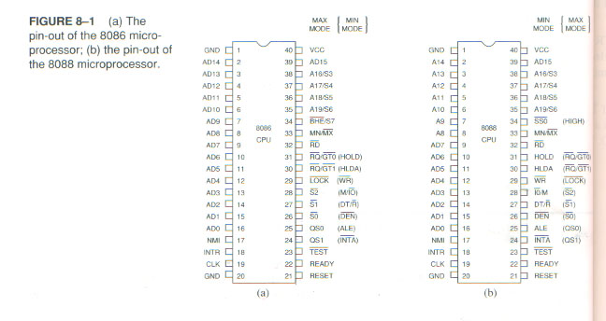

Slide 16
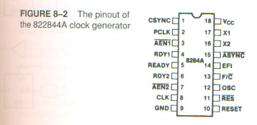
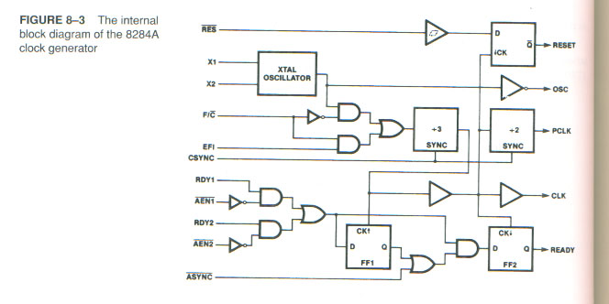

Slide 17
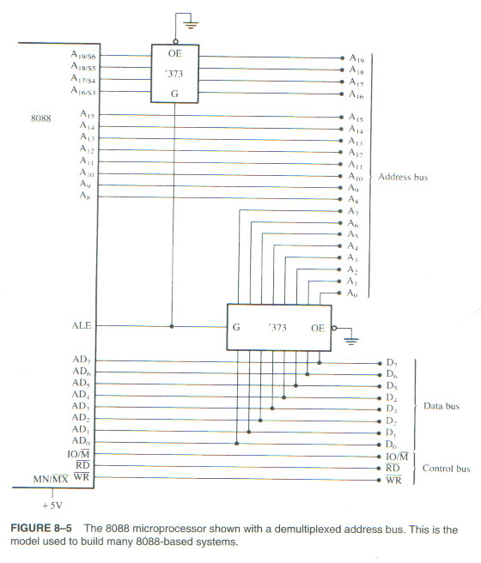

Slide 18
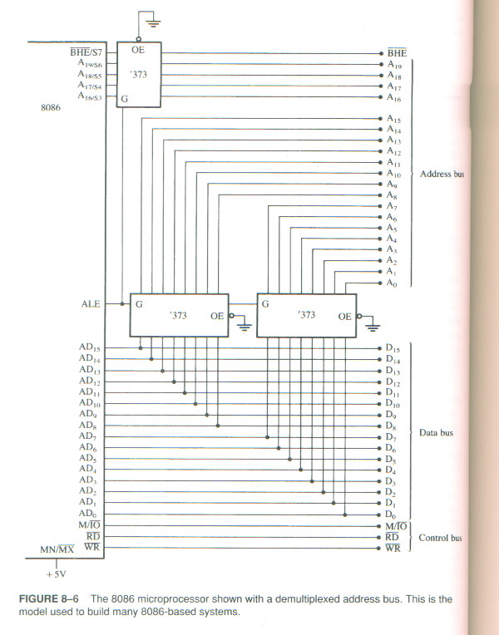

Slide 19
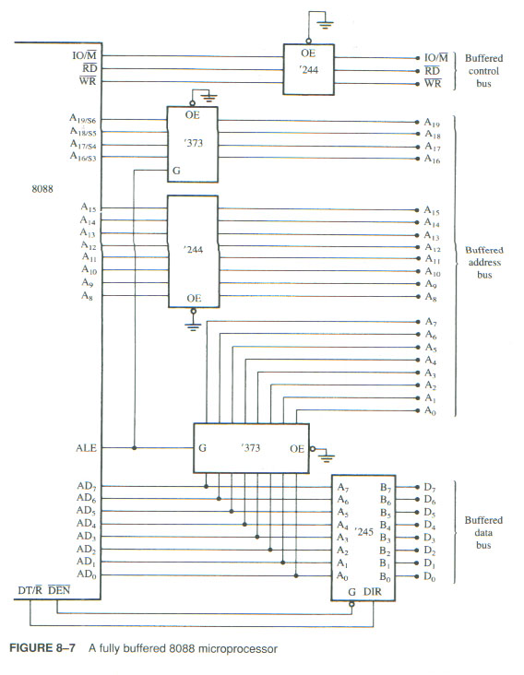

Slide 20
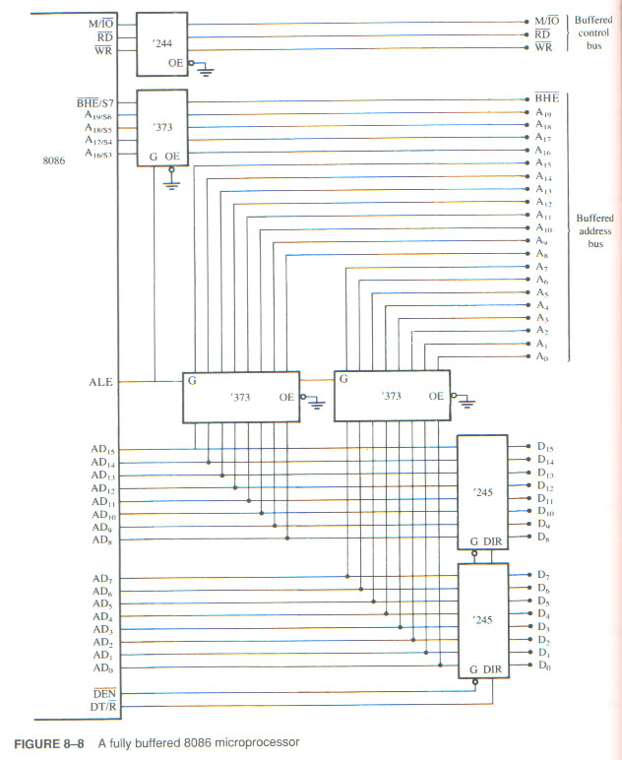

Slide 21
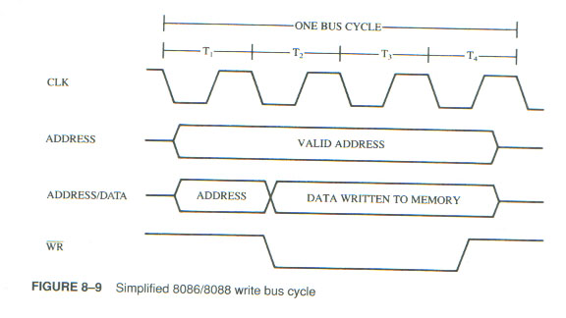
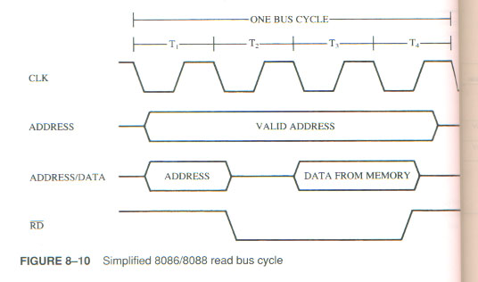

Slide 22
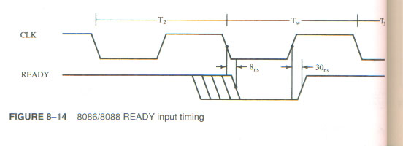
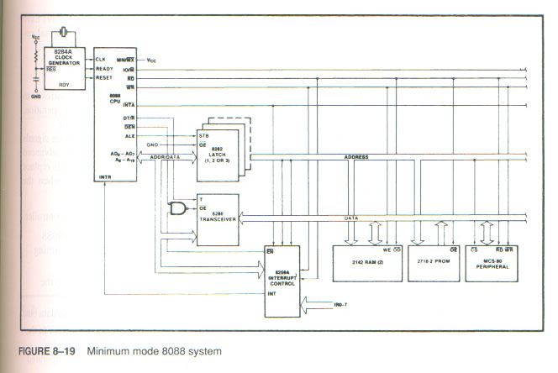

Slide 23
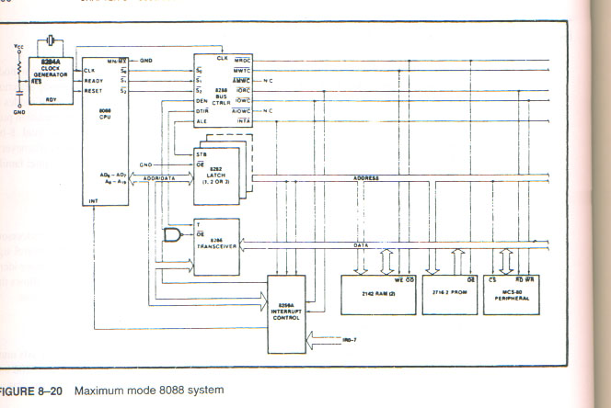

Slide 24
